Slide 1

Predicting Housing Price Index in Montgomery County, Maryland via Machine Learning
Matthew Jacobsen
IBM Advanced Data Science Capstone Course - Coursera

Slide 2
Introduction
What is the Housing Price Index (HPI)?
The HPI is a measure of price changes in residential housing, as a percentage change relative to a specific start year.
Why would we care?
HPI is a measure of the health of the economy it is related to.
If HPI is increasing, then the local economy is healthy and growing.
If HPI is decreasing, then the local economy has some underlying problem that needs addressing at the appropriate government level.

Slide 3
What is the goal?
For those serving in government positions at all levels, the objective is to be a good steward of the local economy.
Understanding what features impact the HPI can help to drive decisions and direct resources where they are needed.
Knowing the relative importance of these features also helps to determine the quantity of resources dedicated to improving a feature.

Slide 4
What data can be used?
Just about any data relating to the local economy can be employed for modelling this, such as:
Per Capita Income
Crime Rates
Educational Quality
Net Migration Rate
However, in order to maintain focus on the econometric features, the data employed in this project is primarily related to local economy and employment.

Slide 5
What data are we using and where did it come from?
The data employed in this project was obtained through the St. Louis Federal Reserve website, which repositories U.S. Federal Government agency data for public use.
In particular, the data gathered for possible use in the model includes:
Gross Domestic Product
Unemployment Rate
Welfare Recipient Population
Percent below the Poverty Level
Per Capita Income
Housing Price Index
Time

Slide 6
What data are we using and where did it come from?
The data employed in this project was obtained through the St. Louis Federal Reserve website, which repositories U.S. Federal Government agency data for public use.
In particular, the data gathered for possible use in the model includes:
Gross Domestic Product
Unemployment Rate
Welfare Recipient Population
Percent below the Poverty Level
Per Capita Income
Housing Price Index
Time

Slide 7
Were there issues with the data?
As with any data management project, there were several issues associated with the data used in this project.
Some of the issues encountered included:
Dissimilar Data Frequency : Interpolation was used to fill in gaps in the data
Dissimilar Data Range : Data was truncated to the shortest time where all data was available
None of these issues resulted in issues with the model.
The single issue that required a change to the model was that the Welfare Recipients feature data was too sparse to interpolate. As a result, it was dropped from the model prior to any fitting.

Slide 8
What Models Were Tested?
In order to develop the best forecasting model possible with this data set, the following models were tested:
Gradient Boosting Regressor
Linear
Elastic Net
Lasso
Ridge
Bayesian Ridge
Orthogonal Matching Pursuit

Slide 9
How was the best model chosen?
Several metrics were employed in determining which model performed the best, such as:
Least Absolute Deviation : An optimization parameter for tuning the number of cycles used in a model.
Median Absolute Error : An outlier insensitive measure of the median residual of the fit.
Goodness of Fit or Score : This is a measure of how “good” the fit is. The higher the number, the better the fit.
E.g. For a line, the goodness of fit should be 1.

Slide 10
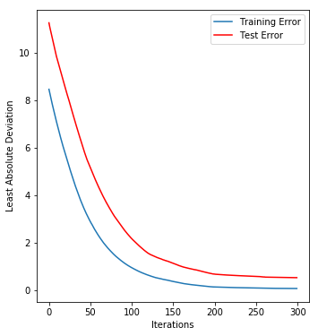
What did the model results look like?
Starting with the Gradient Boosted model:
Parameters were adjusted using a grid search method and run over 300 cycles
The metrics suggested:
Median Absolute Error/Goodness of Fit : 0.381
Least Absolute Deviation : Graph at right
Based upon these results, the Gradient Boosted model was discarded, as it did not perform well and the number of cycles indicated no more improvement was possible.

Slide 11
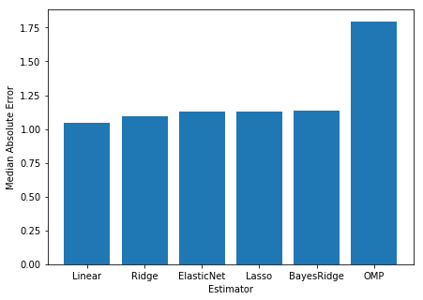
What did the model results look like?
The remaining models were evaluated cyclically, with the scores shown below and the Median Absolute Error shown at right.
Model | Goodness of Fit
Linear | 0.991
Ridge | 0.989
Elastic Net | 0.989
Lasso | 0.989
Bayes Ridge | 0.989
Orthogonal Matching Pursuit | 0.970

Slide 12
What did the model results look like?
As a result of these metrics, the simple multilinear model proved to be the best.
Model | Goodness of Fit
Linear | 0.991
Ridge | 0.989
Elastic Net | 0.989
Lasso | 0.989
Bayes Ridge | 0.989
Orthogonal Matching Pursuit | 0.970

Slide 13
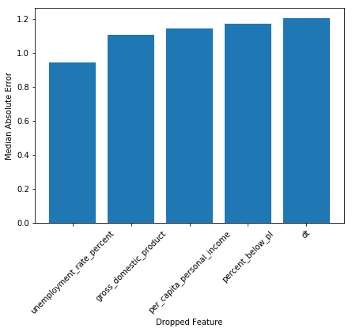
What other optimization was done?
In addition to testing multiple models, the features were dropped checked to see if any substantially improved the model.
As the models performed similarly regardless of metric, all were retained.
Dropped Feautre | Resulting Goodness of Fit
Unemployment Rate | 0.991
Gross Domestic Product | 0.988
Per Capita Income | 0.989
Percent Below Poverty Level | 0.989
Time | 0.986

Slide 14
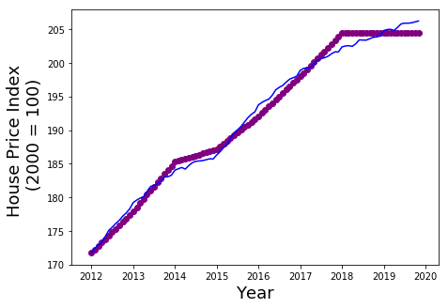
Resulting Model
The final model is:
y= -52.249 + 0.763 * Unemployment Rate + 0.763 * GDP + 1.49e-06 * PCI + -0.001 * % Under Poverty Line + 11.440 * Time
Score: 0.991
Median Absolute Error: 1.05

Slide 15
Conclusions
In order to develop a model for predicting the house price index, a group of data was accumulated and processed into a data set for model development.
After multiple attempted models and assessment metrics, a multi-linear model was chosen, as it performed the best of those tested.
Tuning of the model was attempted, by seeing if dropping of various features resulted in improved model performance. None of these features resulted in a measurable improvement or significant downturn.

Slide 16
Conclusions
While the model itself is simple, it does a reasonable job of replicating the data it was provided.
Use of this model for forecasting may or may not produce good results.
In part, this is a limitation imposed by the data. As there is not sufficient data to include an economic downturn, the model is unlikely to account for this.
Beyond this, the model produced here does show where the county administration will likely see the best result for their efforts.
Unemployment Rate and GDP have similar impacts on the model and should be balanced equally.
Per Capita Income has a very small effect overall. While it does improve the model performance, it may become negligible with other more significant features.
% Below Poverty Line is the only negative influence on the future forecasting of this model. As a result, county government would be well advised to monitor this percentage and attempt to decrease this measure as much as possible for continued property appreciation.

Slide 17
Path Forward
As stated earlier, this model is simple. It does not include other features that might have a strong influence, such as crime rate and education quality.
At the simplest level, these were not included because they are more localized phenomena than the ones employed as features here.
Future development of such a model would need:
Be more locally focused (with appropriate data)
Data with a broader time range
A broader range of data features to employ for fitting

Slide 18
Citations
U.S. Census Bureau, SNAP Benefits Recipients in Montgomery County, MD [CBR24031MDA647NCEN], retrieved from FRED, Federal Reserve Bank of St. Louis; https://fred.stlouisfed.org/series/CBR24031MDA647NCEN, January 6, 2020.
U.S. Census Bureau, Percent of Population Below the Poverty Level in Montgomery County, MD [S1701ACS024031], retrieved from FRED, Federal Reserve Bank of St. Louis; https://fred.stlouisfed.org/series/S1701ACS024031, January 6, 2020.
U.S. Bureau of Economic Analysis, Per Capita Personal Income in Montgomery County, MD [PCPI24031], retrieved from FRED, Federal Reserve Bank of St. Louis; https://fred.stlouisfed.org/series/PCPI24031, January 6, 2020.
U.S. Bureau of Economic Analysis, Gross Domestic Product: All Industries in Montgomery County, MD [GDPALL24031], retrieved from FRED, Federal Reserve Bank of St. Louis; https://fred.stlouisfed.org/series/GDPALL24031, January 6, 2020.
U.S. Bureau of Economic Analysis, Gross Domestic Product: All Industries in Montgomery County, MD [GDPALL24031], retrieved from FRED, Federal Reserve Bank of St. Louis; https://fred.stlouisfed.org/series/GDPALL24031, January 6, 2020.
U.S. Federal Housing Finance Agency, All-Transactions House Price Index for Montgomery County, MD [ATNHPIUS24031A], retrieved from FRED, Federal Reserve Bank of St. Louis; https://fred.stlouisfed.org/series/ATNHPIUS24031A, January 6, 2020.

